Slide 1

Introduction to Software Business Product management
Led by:
Emily Crose
For
Oakland University

Slide 2
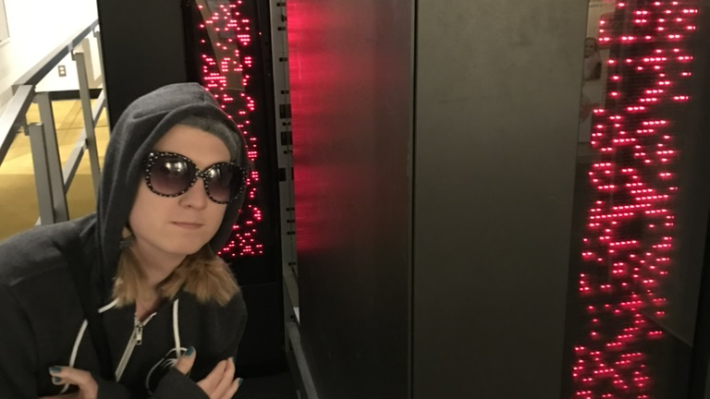
Who am I?
Emily Crose
Information security professional 13 years
Frequent public speaker
Formerly US Intelligence Community
Current research manager @ Sophos

Slide 3

What about you?
Notes:
What about you all? Where do you come from? What kinds of backgrounds do you have?

Slide 4

Course overview
Basic operations of this course
What will we be talking about in this course?
What do you want to learn?

Slide 5
Basic Course Operation
Meet three times/week for 5 weeks
Tuesdays, Wednesdays & Thursdays
7AM Eastern – 10AM Eastern
Moodle
Github
Notes:
We will be meeting 3 times a week on Tuesdays, Wednesdays and Thursdays for the next 5 weeks. We’ll begin around 7AM and end around 10AM Eastern time.
I will make class materials available in two places: Moodle, and Github. Github is one of the tools that we’ll be talking about in this class, so if you want to challenge yourself to put some of what we talk to into practice, jump over to github where the class materials will also be made available.

Slide 6
Course material
Understanding modern technology fundamentals
How it works
How it is maintained
The Software Development Life Cycle (SDLC)
Tools for managing software development
Management techniques for maintaining codebases
Standards that apply to these topics
Notes:
In this class, we’re going to talk about modern technology. How it works, and how we maintain it. We’ll talk about some of the most popular tools you’ll use in this work. You will also have opportunities to be exposed to these tools in this class through presentations, but also though hands-on use for some of these tools if you choose to do so.
We’re going to talk about the Software Development Life Cycle (Also called the SDLC) and how this general principal applies to developing and maintaining codebases. Alongside that topic, we will talk about some management techniques which can be used to help apply the principals from the SDLC to your everyday work.
Finally, we will talk about some of the standards which apply to these topics, and a few that will apply directly to your work.

Slide 7

Hardware vs software

Slide 8

What Defines hardware?
Solid parts of a computer system
Computer parts
CPU
GPU
Memory
I/O components
Keyboard
Mouse
VR headset
Sensors
Temperature
Pressure

Slide 9
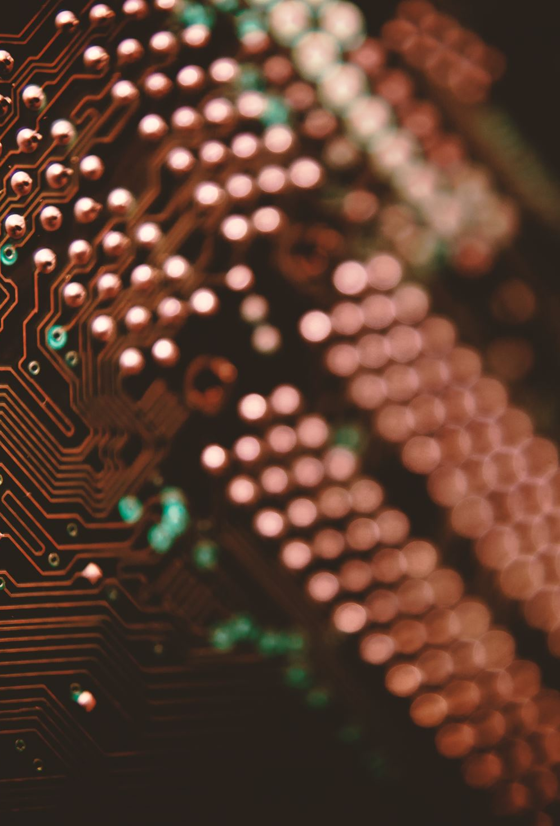
Purpose of hardware
Hardware handles the physical aspect of information processing by generating electronic signals

Slide 10

Purpose of software
Software intercepts the signals generated by hardware
Interprets and manages electronic signals
Provides these interpretations through a series of filters to help humans understand and interact with hardware

Slide 11
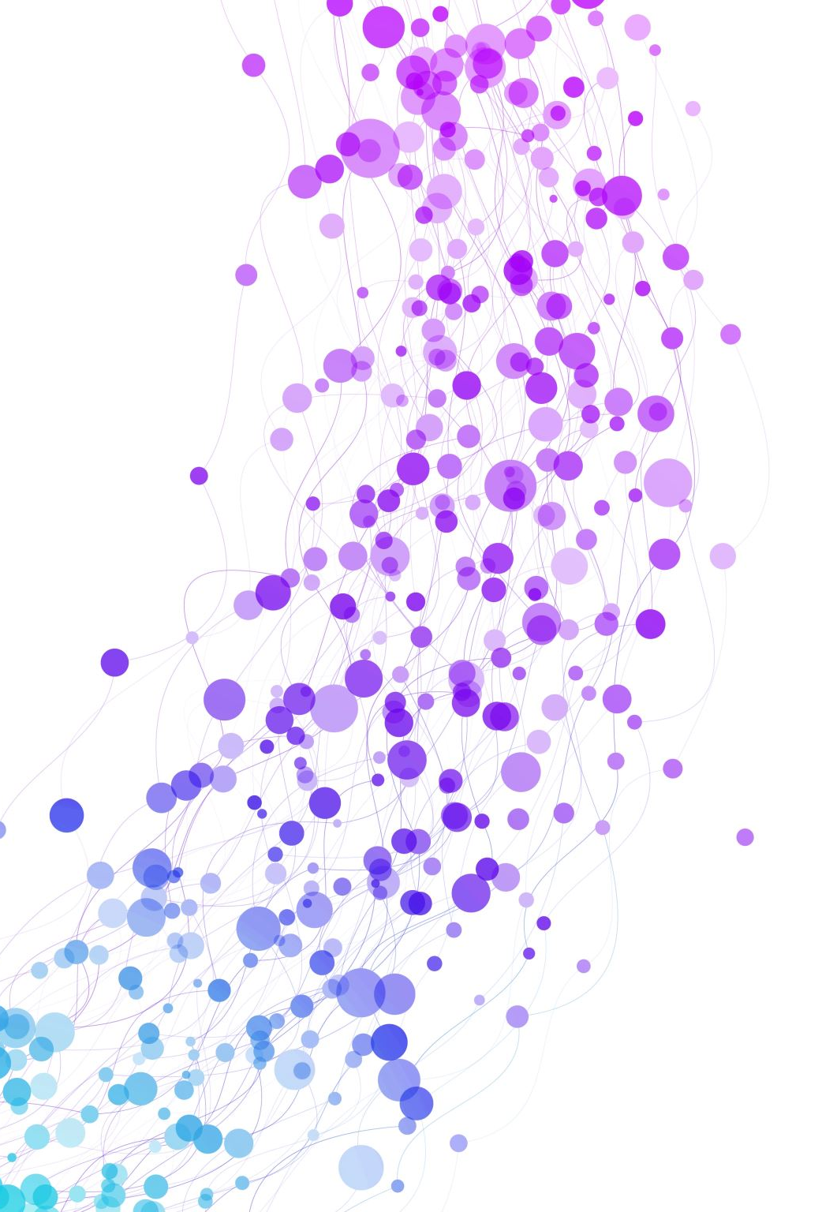
Modern Software operation
Notes:
Today, software development and maintenance has changed from the past in a few key ways. In some ways, it’s a rediscovery of old methods that worked. However, we have also integrated new tools and principles to help guide the improvement and organization of software deployment.

Slide 12

What’s old?
Popular old programming languages
C
C++
Javascript
Assembly
Direct software distribution
“Mainframe” processing?
(More on this later)
Desktop software

Slide 13

What’s new?
Mobile & IOT software
“THE CLOUD”
Tools
Git
Jira
Wiki/Confluence
AI enhanced coding
Notes:
Mobile software has come a long way

Slide 14
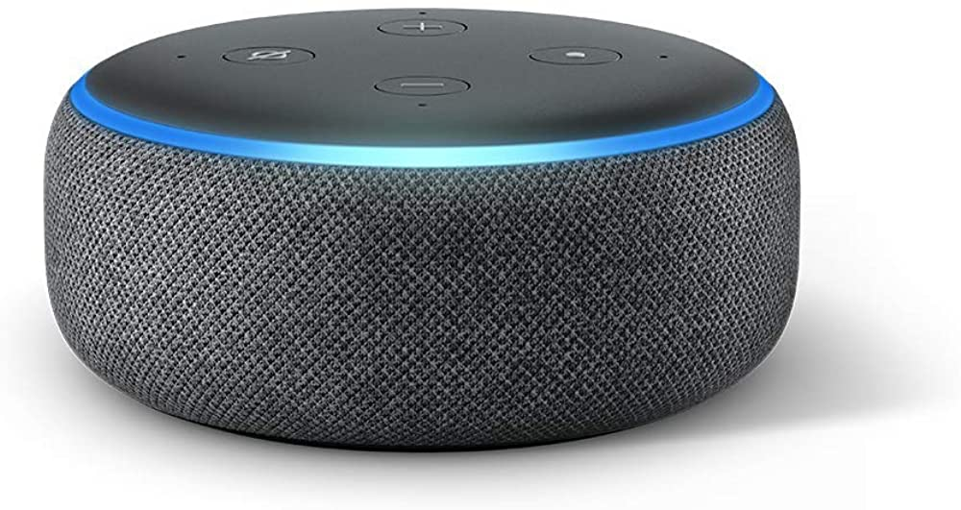
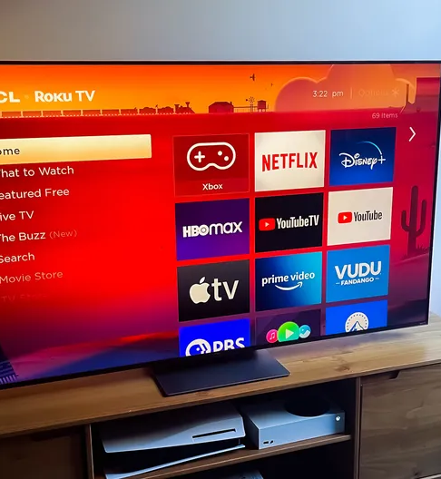
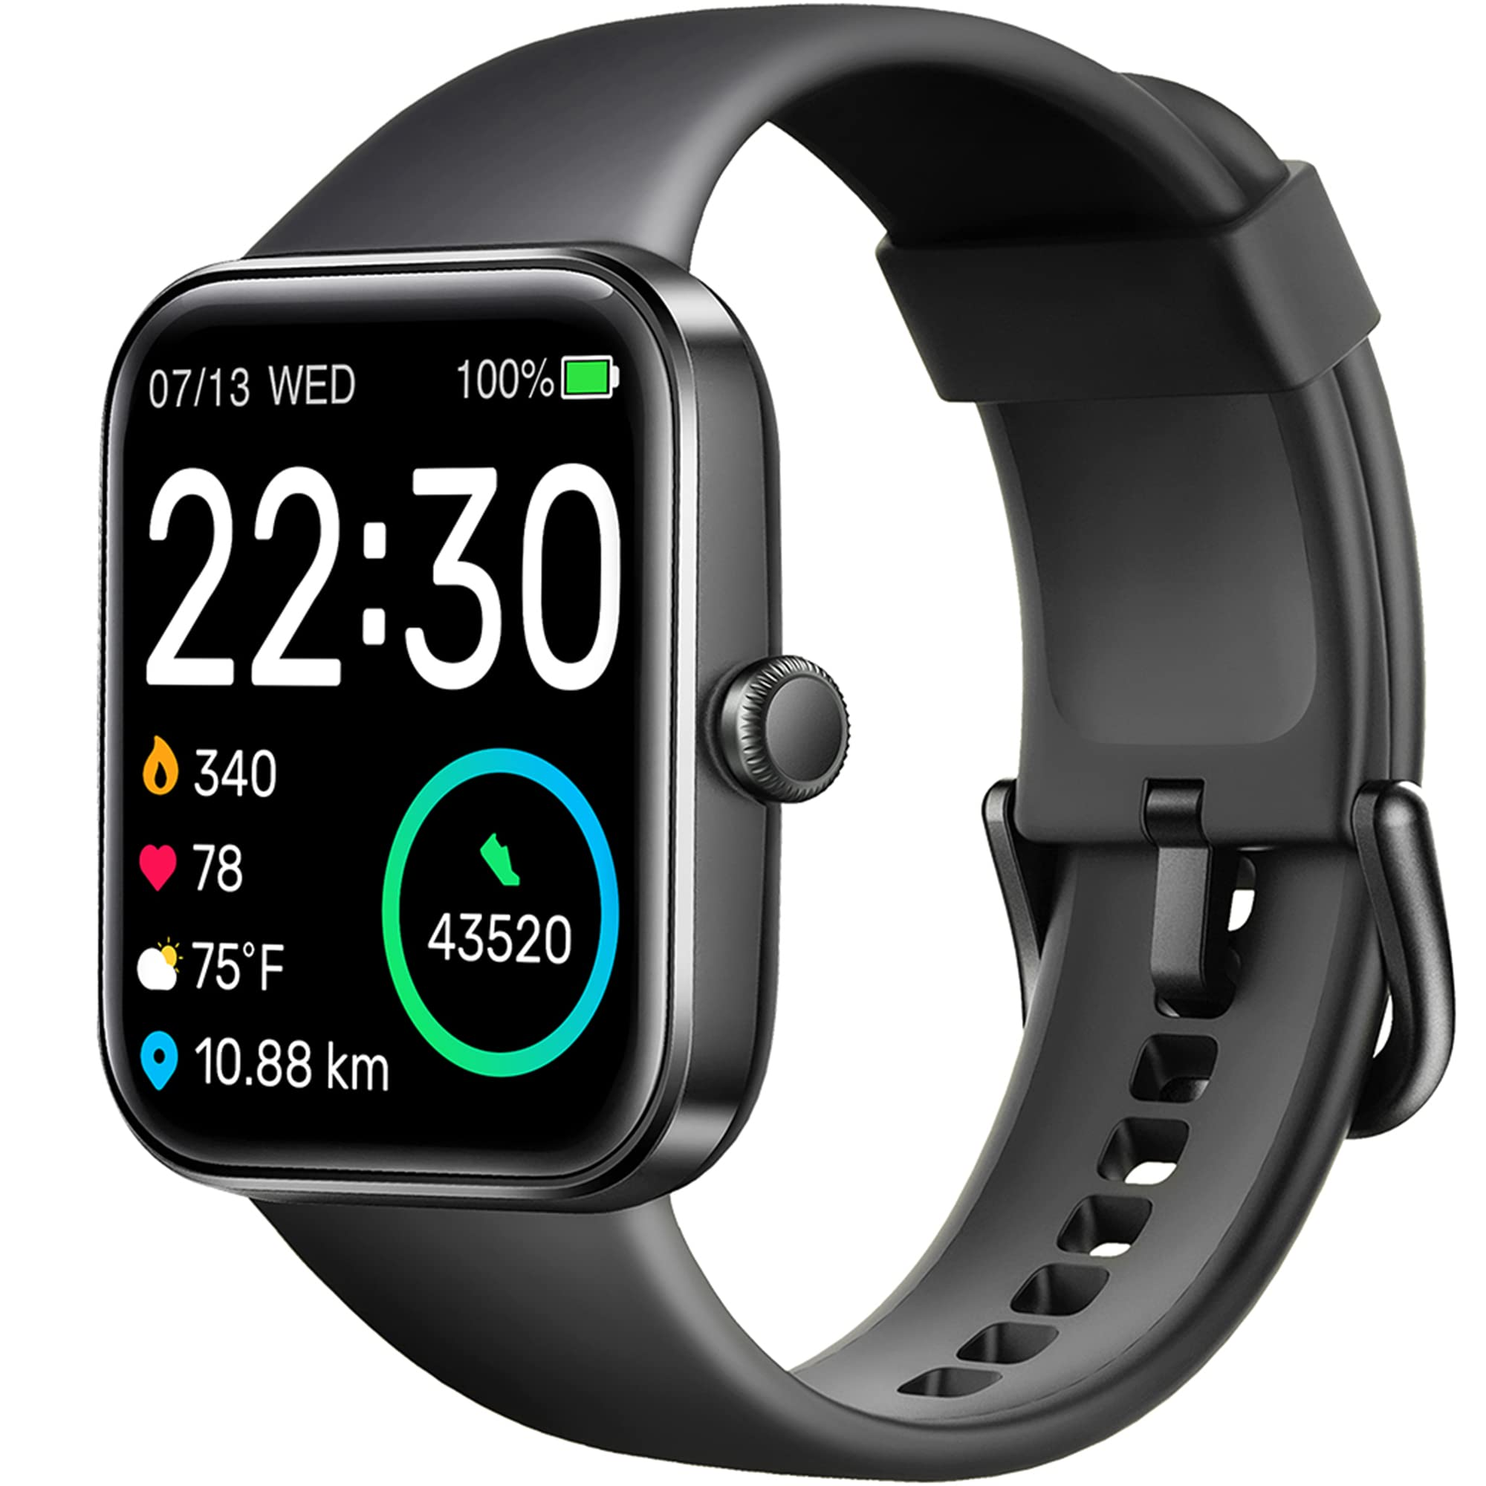
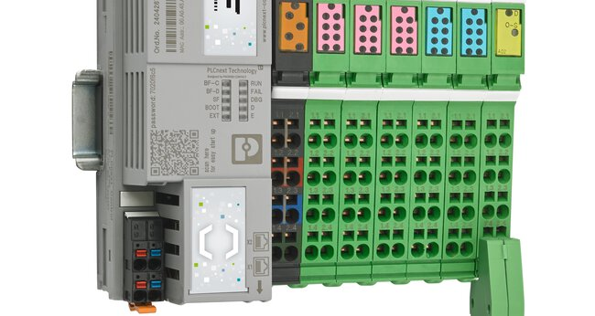

Mobile & IoT

Slide 15

Why is software so important?
Notes:
Because this course is focused on software and software development, we need to get back to focusing on the role of software and why it’s important.

Slide 16
Software makes the world go ‘round!
Notes:
Software is the connective tissue in more ways than one. From Kernel code and embedded software (which is grafted onto hardware)

Slide 17

What can go wrong?
System crash
Exploitation & breach
Risk of injury?
Risk of data loss?
“spaghetti code”
Legacy code maintenance

Slide 18
Basic terminology
Notes:
I’m a firm believer in the idea that you can’t learn anything technical without knowing the lingo, so let’s take a few minutes to talk about some basic terminology that will help us understand future sections. The expectation here isn’t that you will hear these terms and instantly know what they mean. Many of these terms are contextual. This is in no way meant to be THE authoritative list of terminology that may be mentioned over the course of this class though, so if there’s a term that you haven’t heard, please don’t be afraid to ask as soon as you hear the term.

Slide 19
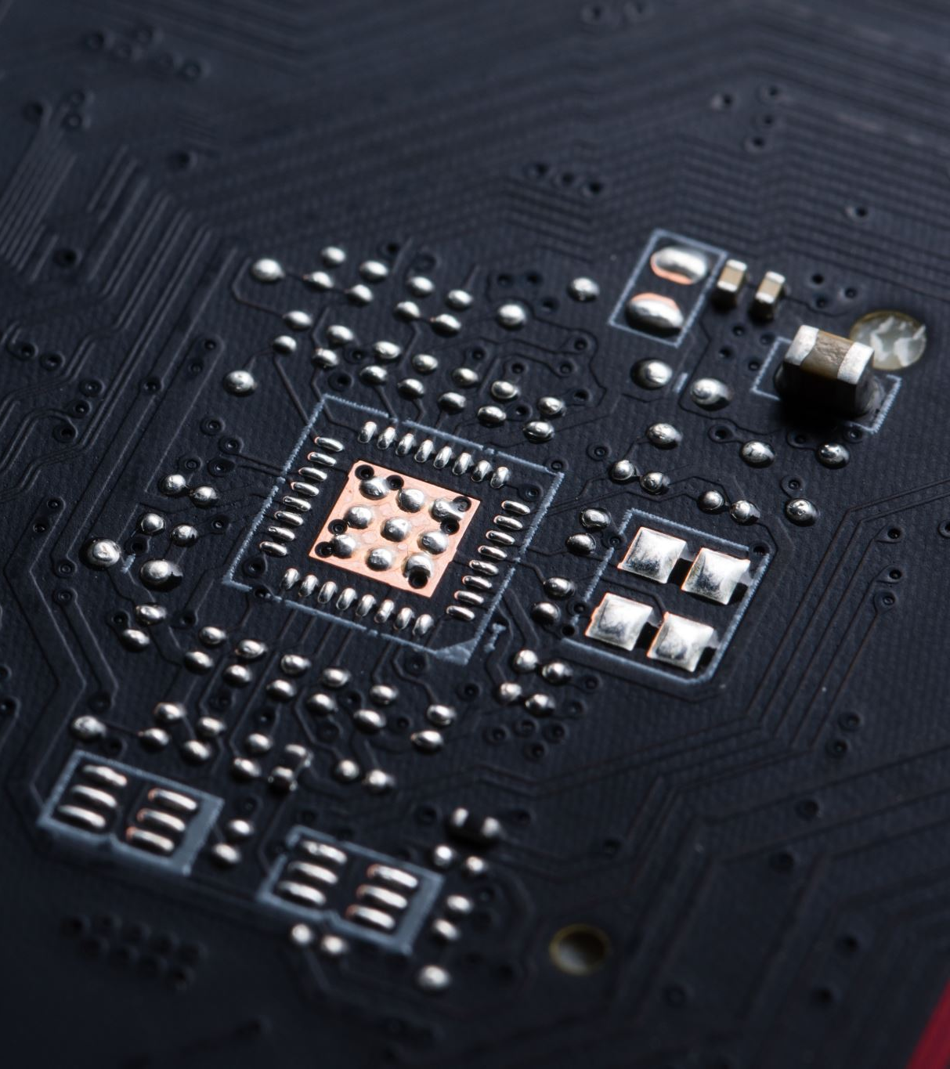
Hardware terminology
Central Processing Unit (CPU)
Random Access Memory (RAM)
Input/Output (I/O)

Slide 20

Software terminology
Execution
When a program runs
Memory allocation
How software is positioned logically inside of memory
Maintenance
Fixing (or squashing) bugs
“Legacy” code

Slide 21
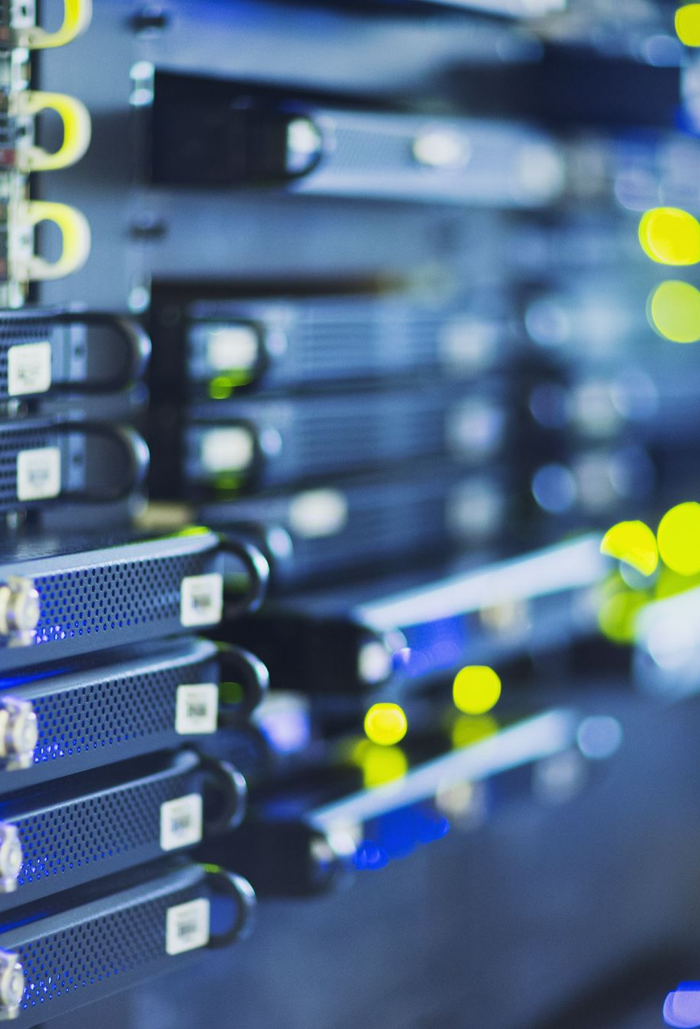
Infrastructure terminology
Infrastructure
Servers
Routers
Architecture
How is our infrastructure arranged?

Slide 22

Change management terminology
Repository (Repo)
Branch
Main/Development
Pull Request (PR)
Push
Origin
Integration

Slide 23
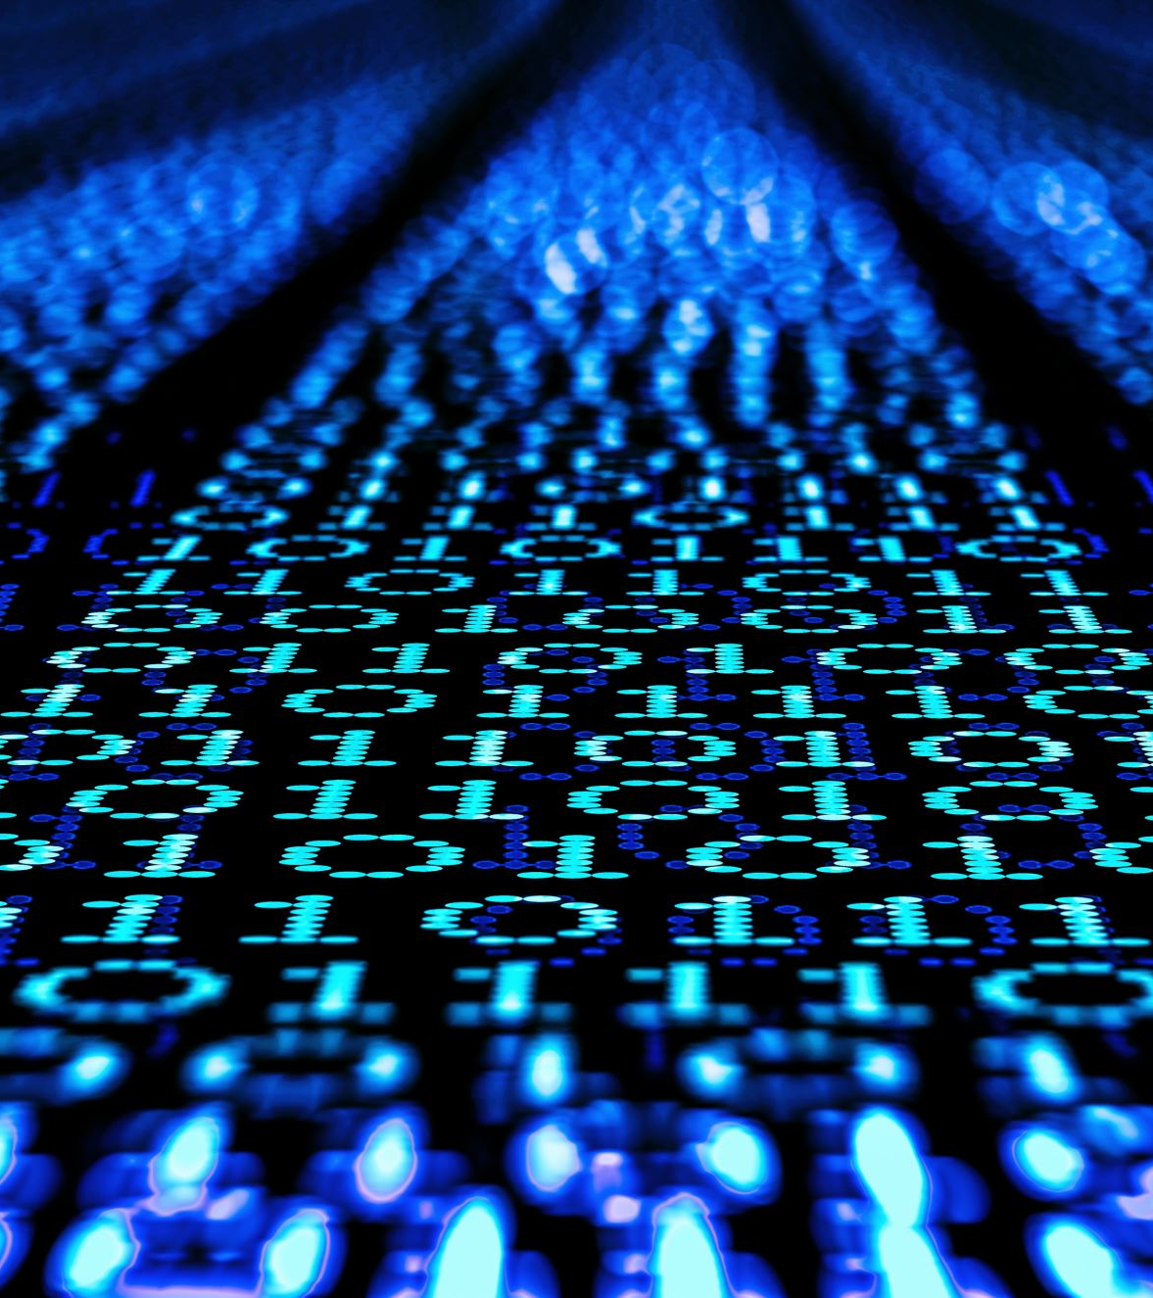
Security terminology
Vulnerability
Exploit
Overflow (buffer/stack)
Breach

